Slide 1
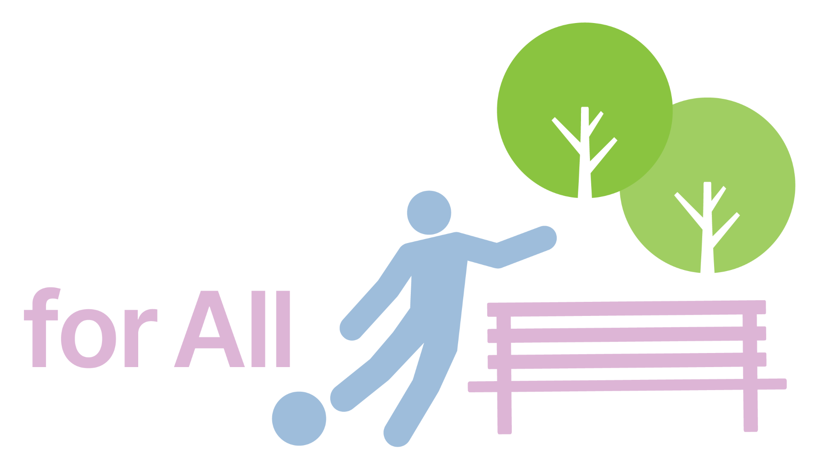
730,000 residents.
230 new acres.
1 better park for all.
Campaign Creative Plan · v4
Most of Liberty State Park has sat locked behind a fence for decades. It's time to clean it and open it for all of Hudson County.

Slide 2
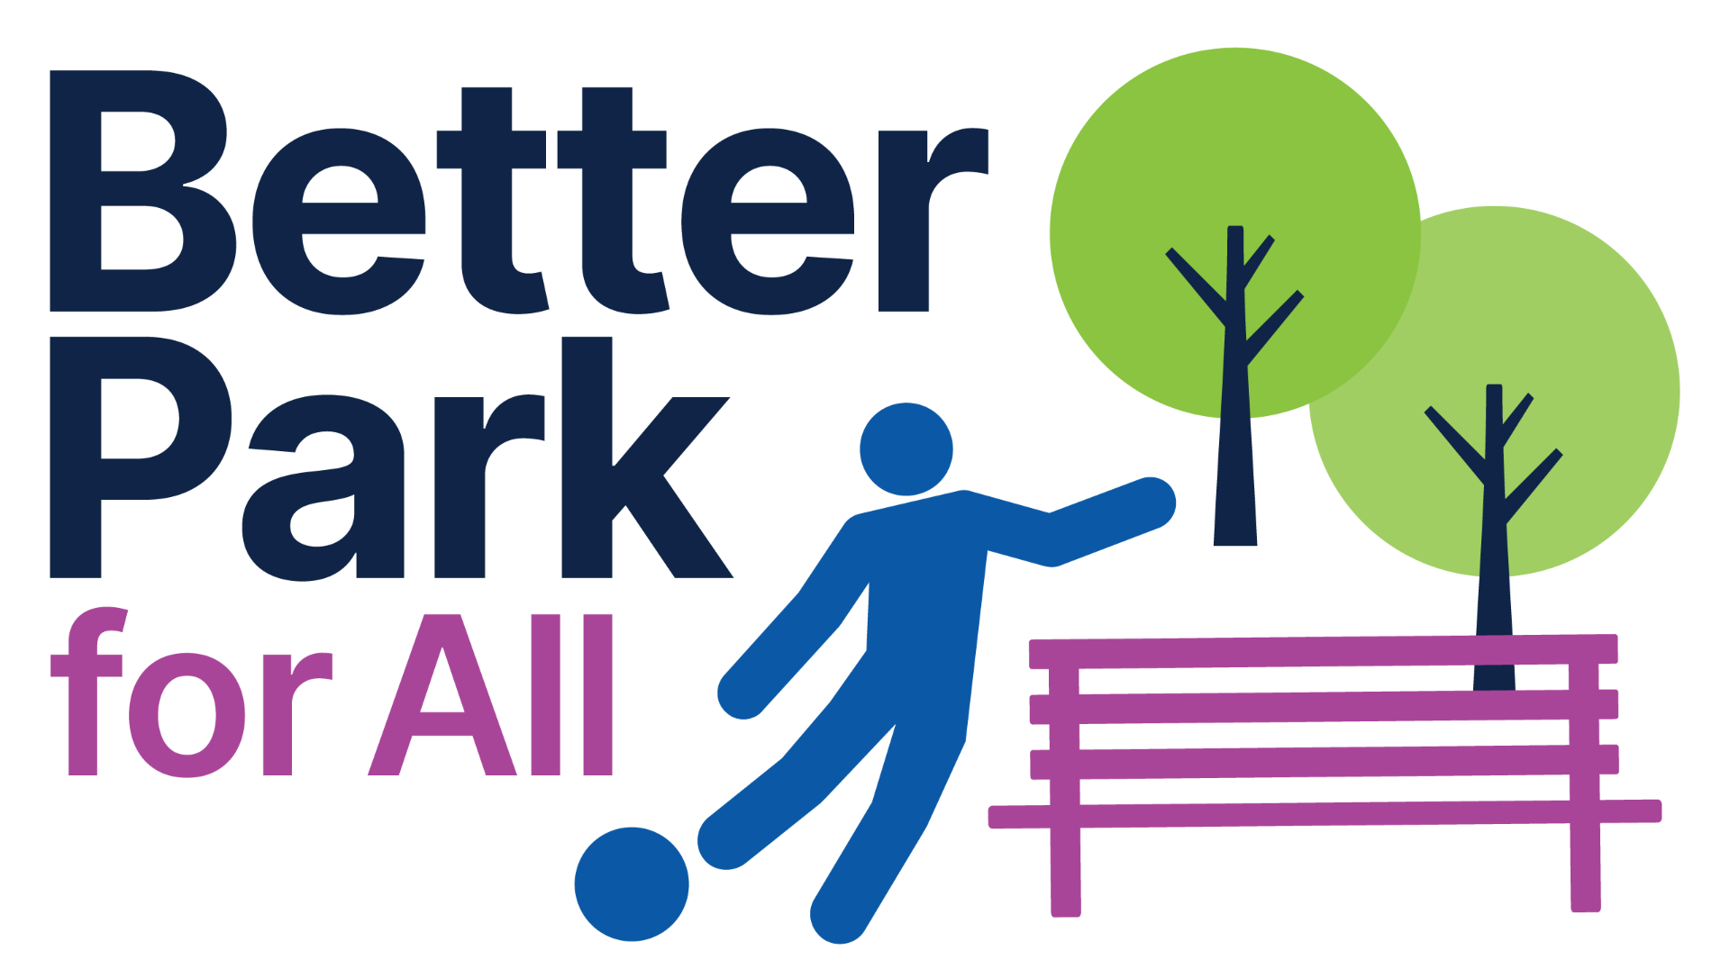
AT A GLANCE
230 acres. 50 years. One park.
The fenced interior of Liberty State Park has been off-limits for half a century. This plan is how we open it.
230
50
1
6
Acres fenced off
Years of waiting
Park, for everyone
Creative workstreams
A Better Park for All · Campaign Creative Plan
1

Slide 3
CORE IDEAS
Three ideas hold up everything.
01
02
03
More Park for More People
Public Land Stays Public
Clean Up the Fenced Land
Every resident deserves a great park — regardless of age, zip code, or how they choose to use it.
230 acres of Liberty State Park belong to the people of New Jersey — not to private interests. Public land is a public right, and it stays that way.
After 50 years behind a chain-link fence, it's time to remediate the land and open it up.
A Better Park for All · Campaign Creative Plan
2

Slide 4
OUR MISSION
Built to serve the community. Owned by the public.
A Better Park for All is a coalition of Jersey City, Hudson County, and statewide residents fighting to reclaim Liberty State Park's 230 fenced, polluted acres for the public. Public land is a public right.
We fight for a park where kids play on real fields, tracks, and multi-use courts; youth leagues have room to compete; seniors and neighbors gather year-round in community spaces; and the park's natural land welcomes birders, walkers, and anyone who needs a breath of fresh air.
A Better Park for All.
A Better Park for All · Campaign Creative Plan
3

Slide 5
CREATIVE ASSET OVERVIEW
Six workstreams.
01
02
03
Landing Page
Table-Setter Video
Validator Video Series
Digital home for all audiences to learn more and get involved.
A :30 spot explaining the problem, the coalition, and the vision.
Short social videos featuring trusted community members.
04
05
06
Static Content
Stakeholder & Coalition Materials
Earned & Sponsored Media Support
Strong, engaging graphics and copy for campaign and outreach.
Toolkits to support the coalition and the cause.
Polling graphics, event signage, and creative support.
A Better Park for All · Campaign Creative Plan
4

Slide 6
TEAM & OWNERSHIP
Who's building what.
CAMPAIGN & CREATIVE
LEGISLATIVE, REGULATORY LOBBYING
Moxie
Lobbying Team (Nevins, Eric, Kevin and Mike)
Strategy and campaign management, table-setter and validator video, coalition website / landing page, static content, finalized materials and one-pagers, and polling. Stakeholder deck and coalition materials to be reviewed by the full team as overall outreach materials.
Direct engagement with elected officials, staff, and civic leadership across the county.
A Better Park for All · Campaign Creative Plan
5

Slide 7
AUDIENCES
Two tracks. Two conversations.
Messaging, executions, and media plan all flow from who we're trying to reach.
TRACK 2
TRACK 1
Hyper-engaged general public
Stakeholders
Elected officials, staff, and civic leadership. What they see everywhere they look shapes what they feel able to move on.
Segmented from cross-tabs data (once the county poll is fielded), this will be a very engaged sliver of the electorate — the most active and influential with elected officials. Further segmentation by demographic with tailored messaging.
WHY THIS MATTERS NOW
Free, family-friendly recreation is an affordability issue. Families across Hudson County are stretched by rising costs and property taxes. A clean, open, public park is one of the few things that gives families relief without asking them to pay for it — and everything new is built on land that's been off-limits for 50 years.
A Better Park for All · Campaign Creative Plan
6

Slide 8
01 · COALITION WEBSITE
Seven pages, one coalition.
A digital home for all audiences to learn more and get involved.
01
02
03
04
Home
Our Mission
Community Voices
Research & Polling
The problem, the vision, the ask.
Coalition statement and what we're fighting for.
Quotes and videos from residents and validators.
Data on public support and park use. Added later, once research is ready to promote.
05
06
07
News & Updates
About Us
Get Involved
Coalition partners and organizational backing.
Press, statements, and campaign milestones.
Sign up, volunteer, share.
A Better Park for All · Campaign Creative Plan
7

Slide 9
01 · COALITION WEBSITE
Example layout — Home
i · THE PROBLEM
HERO IMAGE / AUTO-PLAY VIDEO
Most of Liberty State Park is still fenced off.
Kid(s) with a soccer ball standing on one side of a fence, looking through into the park. Recreated near the site. Doubles as the cover frame for the :30 table-setter, which auto-plays on load.
230 acres of Liberty State Park are fenced off from the community. But we can build a park that serves everyone: from pickleballers to birders, youth athletics to environmental preservation.
ii–vii · PAGE SECTIONS
Our Mission — coalition statement
Community Voices — quotes + videos
Research & Polling — added when ready
News & Updates — press and milestones
About Us — partners and backing
Get Involved — sign up, volunteer, share
Join the coalition →
CTA copy · "Join Hudson County residents who believe we deserve a Better Park for All"
A Better Park for All · Campaign Creative Plan
8

Slide 10
02–04 · CREATIVE ELEMENTS
The pieces we'd build.
High-level introductions to each creative component. Scripts and storyboards follow.
02 · ANCHOR SPOT
02B · INTERACTIVE
Table-Setter Video — :30
Digital Stakeholder Deck
:30-second table-setter with a compelling review of the problem, the vision, and a call to take action.
A digitally-hosted deck so stakeholders can understand the vision — motion-animated renderings, before/after comparisons, and the specific ask for each audience.
03 · SHORT SOCIAL
04 · CROSS-PLATFORM
Validator Video Series
Static Content
Short clips from trusted community voices — factual, warm, in their own words. NAACP, seniors, bilingual voices, kids, Sen. Stack, CE Guy.
Headlines and copy built to travel — including a dedicated “Public land, kept public” set, plus before/after slider treatments.
A Better Park for All · Campaign Creative Plan
9

Slide 11
05–06 · SUPPORT
Support materials and voice.
05
06
ALWAYS
Stakeholder & Coalition Materials
Earned & Sponsored Media
Voice & Tone
“Us,” not “them.” Community-driven. Specific. Hopeful. Never alarmist.
Polling graphics, event signage, and other creative support.
One-pager, FAQ, deck, and coalition support materials.
A Better Park for All · Campaign Creative Plan
10

Slide 12
02 · TABLE-SETTER · OPTION A
For Five Decades, For Our Neighbors
Voiceover | Visual
For five decades, over two hundred and thirty acres of Liberty State Park has sat contaminated and unusable for the public. | B-roll of the park looking contaminated, dilapidated, and gross.
For five decades, Hudson County has watched as promise after promise to finally clean up the park was broken. | B-roll of people walking past the fence and kids staring through it.
It's finally time for a Better Park for All — | The fence being pushed down.
for parents, kids, seniors, coaches, community leaders, environmental advocates, and for our neighbors. | Hero shots of a parent, their kids, seniors, a coach, a multiracial group, environmental activists, then the entire group together.
Let's clean up the park, tear down the fence, and make a Better Park for All. | Logo lockup.
:30 · 78 words
The anchor script. A sweeping, community-wide frame — five decades of broken promises, a fence coming down, and a park built for everyone.
A Better Park for All · Campaign Creative Plan
11

Slide 13
02 · TABLE-SETTER · OPTION B
Soccer on the Sidewalk
Voiceover | Visual
Young child (10): I live across the street from Liberty State Park, but I play soccer… here, on the sidewalk. | A group of kids playing soccer on the sidewalk across the street from the park. Fence in the background.
Most of the park has been fenced off for my whole life, and my parents' whole life. | Kid direct-to-camera.
They're really old. | Kid to offscreen.
One day I'll play soccer on a real field. Walk with my abuela in a big park. | Portraits of Jersey residents together: parents cheering on kids' soccer, teens watching a movie, adults cheers-ing glasses.
So listen up, adults: take down the fence, clean up the park, and open it for everyone in Hudson County. | Logo lockup.
What's a county? | Kid to offscreen.
:30 · 77 words
A kid-led script. A ten-year-old plays soccer on the sidewalk across from a fenced-off park — direct, disarming, and pointed at the adults who can fix it.
A Better Park for All · Campaign Creative Plan
12

Slide 14
02 · TABLE-SETTER · OPTION C
Coach Hurley
Voiceover | Visual
Coach Bob Hurley: My best players grew up playing basketball on courts in public parks and public schools. I can't imagine winning a championship without that most basic resource. | Bob Hurley direct-to-camera, intercut with archival footage of his teams winning championships.
But for most of my life, Liberty State Park has left 230 acres polluted and unusable. Kids nearby don't have a court to play on. | B-roll of the park looking contaminated, dilapidated, and gross.
I believe in a better park for all — especially our kids. It's time to clean it up and make use of it, with something for everyone: pickleballers, birders, environmental preservation, and youth athletics. | B-roll of pickleballers, a group watching birds, advocates testing soil in a preserved area, and Coach Hurley watching young kids play.
Let's clean up the park, tear down the fence, and make a Better Park for All. | Logo lockup.
:45 · 102 words
A validator-led anchor. Coach Bob Hurley connects championship basketball to the public courts and parks that made it possible — and makes the ask for the next generation.
A Better Park for All · Campaign Creative Plan
13

Slide 15
02B · DIGITAL STAKEHOLDER DECK · 1/2
Walk stakeholders through the park, then and now.
Section | What it covers
The park today | Aerials and ground-level views of the 230 fenced acres — what stakeholders and residents actually see when they walk the perimeter.
How we got here | The short history of contamination, broken promises, and the DEP status of the interior — framed for a policy audience.
The vision | Motion-animated renderings of the remediated park — pickleball, youth athletics, birding, wetlands, and preserved open space — mapped onto the current fenced footprint.
Web-hosted · interactive
A digitally-hosted deck so stakeholders can understand the vision — motion-animated renderings of the remediated park, before/after comparisons, and the specific ask for each audience.
A Better Park for All · Campaign Creative Plan
14

Slide 16
02B · DIGITAL STAKEHOLDER DECK · 2/2
Walk stakeholders through the park, then and now.
Section | What it covers
Before / after | Side-by-side of the fenced center today vs. the opened park after remediation, so stakeholders can see the change in one frame.
Who it's for | The 730,000 Hudson County residents and 4.5M annual visitors who would gain access, with the communities closest to the fence called out.
The ask | What we need from each stakeholder audience — legislators, agencies, coalition partners — and the timing that follows Guy's kickoff.
Web-hosted · interactive
A digitally-hosted deck so stakeholders can understand the vision — motion-animated renderings of the remediated park, before/after comparisons, and the specific ask for each audience.
A Better Park for All · Campaign Creative Plan
15

Slide 17
03 · VALIDATOR VIGNETTE SERIES
Script options for validator vignettes
Example scripts across trusted messenger types. Final talent and demo mix will be driven by data recommendations.
Coach Bob Hurley
Senior · 45-year resident
:30 · 70 WORDS
:30 · 79 WORDS
What's the first part to a team's success? Having a space to play and practice. Good courts and fields aren't just important for athletes when they're competing, but for all kids when they're spending time off their iPads and outside together. And without good courts and fields, kids can never experience winning a championship. Let's tear down the fence, open Liberty State Park and make a Better Park For All.
I've spent a lot of time in Liberty State Park. I used to run through it, but now I can just take walks. I always see the perimeter of the fence, wondering when I'll get to see the other side. When will I see more kids and families enjoying this land that belongs to all of us. I've waited long enough. It's time to tear down the fence, open Liberty State Park and make a Better Park For All.
VISUAL: Coach Hurley direct-to-camera. Cut to teenagers playing basketball outside, then college kids in a nice gym. Back to DTC.
VISUAL: Senior direct-to-camera. B-roll of them walking through the park for exercise. They stop at the fence. Back to DTC.
A Better Park for All · Campaign Creative Plan
16

Slide 18
03 · VALIDATOR VIGNETTE SERIES
Validator vignettes (cont.)
Latina parent of three
Environmental advocate
:30 · 75 WORDS · BILINGUAL VERSION AVAILABLE
:30 · 83 WORDS
With the rising costs of everything, Hudson County deserves a place where parents can bring their kids to play. For Free! A place for the entire community to come together. Not just an “affordable” option, a free one. Opening Liberty State Park up with more places for families can make life better for families near and far. It's time to tear down the fence, open Liberty State Park and make a Better Park For All.
I've devoted my life to preserving the environment. We all should care about the air we breathe, the water we drink, and the world around us. Having a toxic site so close to home is damaging and dangerous. New Jersey needs to clean it up, preserve it, and turn it into something useful — for us, for the animals, for our air, and our water. It's time to tear down the fence, open Liberty State Park and make a Better Park For All.
VISUAL: Latina parent direct-to-camera. Watching their kids play with others on a jungle gym, running through a field. Can also be produced bilingual English/Spanish for Spanish-language placements.
VISUAL: Advocate direct-to-camera. Running a test on the ground soil, bird watching, b-roll of local animals. Back to DTC.
A Better Park for All · Campaign Creative Plan
17

Slide 19
03 · VALIDATOR VIGNETTE SERIES
Validator vignettes (cont.)
Richard Smith · President, NAACP New Jersey State Conference
:30
A great public park shouldn't depend on your zip code or your income. For 50 years, 230 acres of Liberty State Park have sat fenced off and out of reach — and the families who live closest have waited the longest. Every resident of this city deserves a clean, open, welcoming park. That's what a better park for all really means.
VISUAL: Richard Smith direct-to-camera. B-roll of the fenced perimeter and nearby neighborhoods, families walking the edge of the park, then wide shots of the open portions in use. Back to DTC.
A Better Park for All · Campaign Creative Plan
18

Slide 20
04 · STATIC CONTENT
Static concepts — copy and visual direction.
Headline, subhead, and visual direction for each static. Graphics not yet produced.
01
02
Tear down the fence. Open the park.
Most of the park… still fenced off.
Sub: A Better Liberty State Park for All.
Visual: A kid holding a soccer ball stands looking through a chain-link fence into the park. Logo included.
Sub: A Better Park for All.
Visual: Bird's-eye view of the park with the 230 fenced-off acres blacked out — designed to show they're completely missing.
03
04
Liberty State Park isn't complete.
Something for everyone, all owned by the public.
Sub: Join our campaign for A Better Park For All.
Visual: Bird's-eye view with the fenced acres blacked out — alternate treatment. Logo included.
Sub: A better Liberty State Park for all.
Visual: Static/GIF slider with before/after variants for pickleball, birding, youth athletics, and environmental protection.
A Better Park for All · Campaign Creative Plan
19

Slide 21
07 · TIMELINE
Where we are, where we're going, and what has to happen first.
Phase 1 is the build — poll in field, coalition landing page, and creative development. Phase 2 is the two-track paid launch after Labor Day, gated by the poll's public release.
PHASE 1 · BUILD
PHASE 2 · LAUNCH
Now → Labor Day
3 months · Two tracks
Produce the campaign ecosystem before public launch — four workstreams running in parallel: digital landing page, creative production, field poll, and outreach for both stakeholders and elected rollout strategy.
Orchestrate timing of the Guy kick-off and campaign launch. Full paid-campaign review and sign-off in August so we're ready to launch at go.
LAUNCH GATE · POST-LABOR DAY
Phase 2 goes live when three conditions are met: (1) the poll is public and cross-tabs are in hand, (2) the landing page and CRM are live and validated, and (3) the table-setter, validator series, and static library are approved and shipped to media. Endorsers announce on their own timing and trigger opportunistic activations throughout.
A Better Park for All · Campaign Creative Plan
20

Slide 22
PHASE 1 · BUILD
Getting the campaign ready to launch.
Four workstreams running in parallel between now and Labor Day.
01 Countywide poll
02 Coalition landing page
WHERE WE ARE
WHERE WE ARE
Poll draft to be circulated today; final edits suggested by July 31 — fielding scheduled for August.
Approved and in build · prior invoice.
WHAT HAS TO HAPPEN
WHAT HAS TO HAPPEN
Finalize instrument, field the poll, deliver toplines + cross-tabs.
Complete sitemap build, wire CRM sign-ups, load validator quotes and mission content.
WHY IT GATES LAUNCH
WHY IT GATES LAUNCH
Cross-tabs segment the Track 2 audience and confirm message priorities. Public release gives the County Executive cover to go public.
Live and CRM-connected before any paid traffic — every ad drives here to sign, share, or learn more.
A Better Park for All · Campaign Creative Plan
21

Slide 23
PHASE 1 · BUILD
Phase 1 workstreams (cont.)
03 Creative development
04 Coalition & stakeholder outreach
WHERE WE ARE
WHERE WE ARE
Moxie to share scripts for review and sign-off by July 31. Production in August.
Now that renderings are complete, build out outreach materials.
WHAT HAS TO HAPPEN
WHAT HAS TO HAPPEN
Produce table-setter video, validator series, and static library. Confirm site access and drone permissions for the fence-line shoot.
Moxie and Connell Foley to update and refresh all materials for the varying outreach meetings required (stakeholder, elected, etc.).
WHY IT GATES LAUNCH
WHY IT GATES LAUNCH
All Phase 2 spend needs finished creative in market on day one — no launch without it.
Assist lobbying teams in their briefings and asks prior to launch; refresh supportive stakeholders and recruit new allies.
A Better Park for All · Campaign Creative Plan
22

Slide 24
PHASE 2 · LAUNCH
Two tracks, twelve weeks.
Working with the lobbying team to time the Guy announcement and campaign launch.
TRACK 1 · 12 WEEKS
TRACK 2 · 12 WEEKS
Stakeholder audience program
Grassroots education & mobilization
TARGETS
TARGETS
Elected officials, staff, and civic leadership throughout the county. Custom audience hand-built by Moxie. Est. 5–10k size.
Likely supporters based on polling and modeling data — excluding Solomon's strongest districts in Wards E and F, and excluding enviros.
STRATEGIC GOAL
STRATEGIC GOAL
Constant pressure, extremely high frequency to manufacture the feel of a big moment.
Weeks 1–6 education to all active registered Dems; weeks 7–12 mobilization and petition signatures.
TACTICS
TACTICS
Streaming TV · Streaming Audio · Facebook · Instagram · LinkedIn · Online Video · Display
Meta · Streaming TV · Streaming Audio · Online Video · Display · Search · CRM
A Better Park for All · Campaign Creative Plan
23

Slide 25
Public land, kept public.
A better park for all.
Moxie Strategies · Campaign Creative Plan v4

